Slide 1
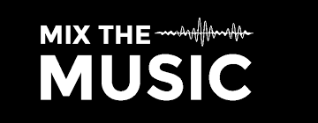
DUBMIX
By: Richard Rodas, Jin Lee

Slide 2
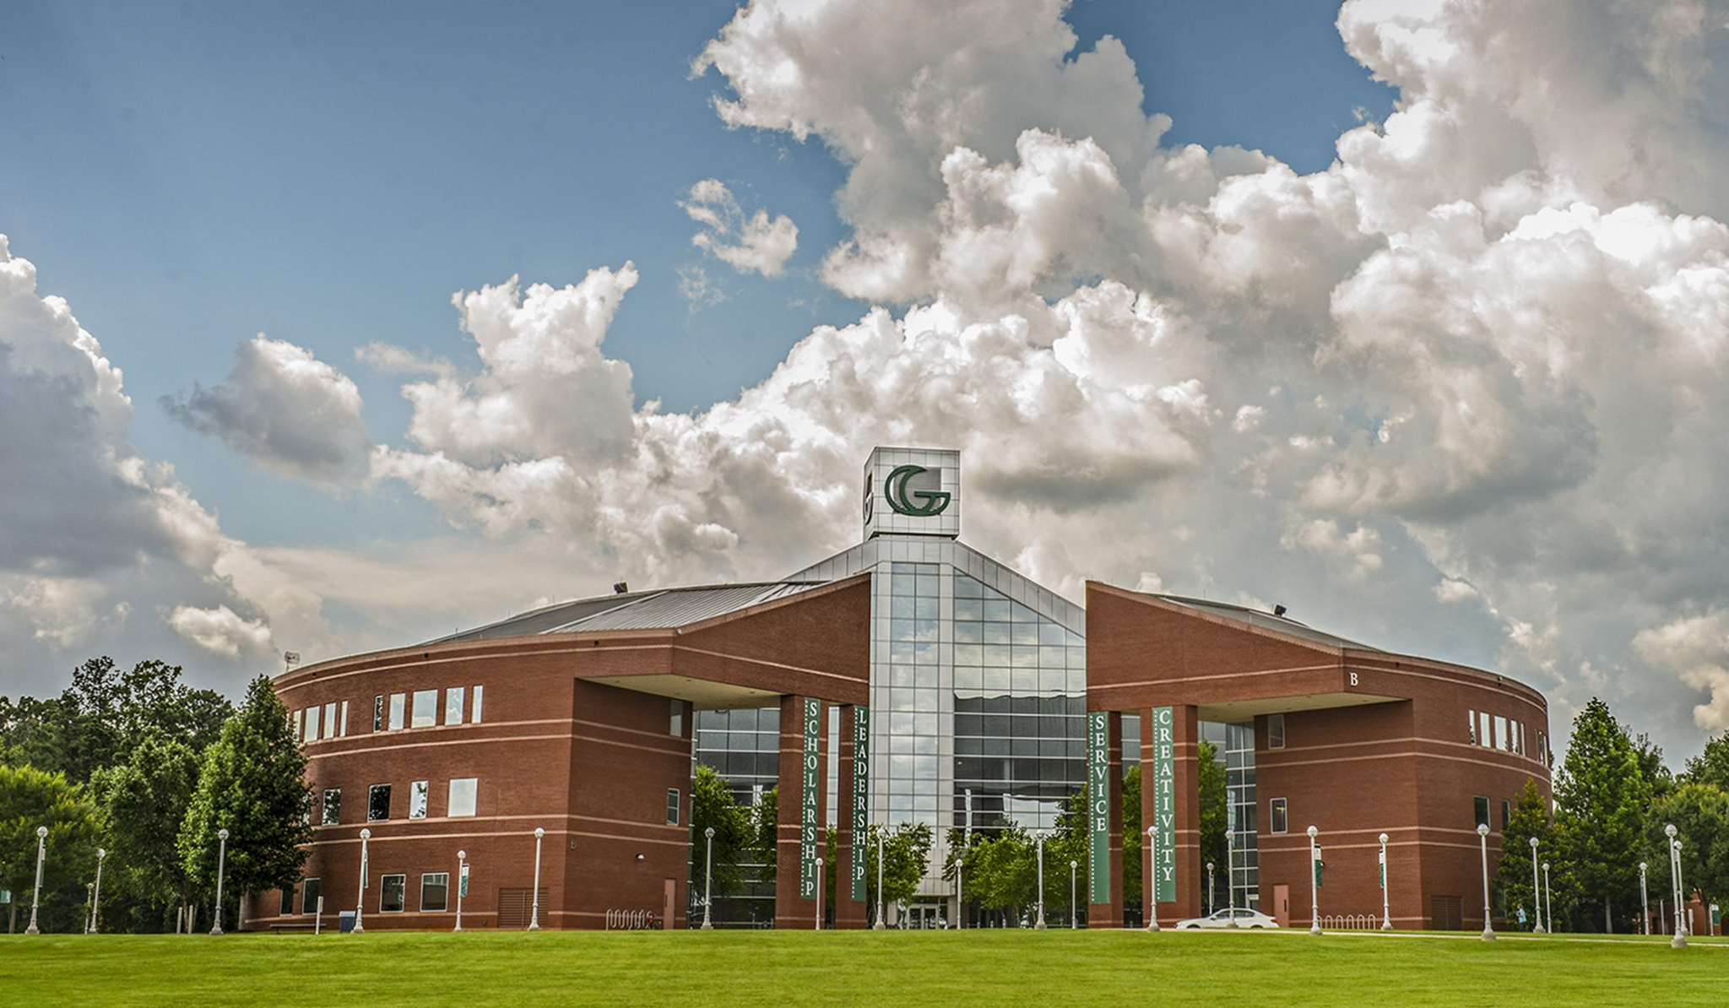
TAP Program
What is TAP?
The Technology Ambassadors Program (TAP) is focus on commitment to service learning. This program addresses a need to increase the number of students who go on pursuing an IT major/minor, especially those underrepresented in computing.
You get to work on exciting projects, build peer-to-peer connections, and enhance on your technical skills.
What is the goal of a TAP project?
A TAP Project’s goal is to introduce the idea that whether you have little to no experience, you can create and discover new things to make and share.

Slide 3
GOALS
Our goal is to engage kids to develop an interest in coding through the rhythm of music!
Motivate people to experience technology that benefits their future endeavors.
Jam to music while actively learning how to code.
GOALS
GOALS

Slide 4
Project Description
DubMix is a workshop based around having students create their own music track via coding, and importing that music track into a rhythm game.
The bulk of the educational aspect will take place in Ear Sketch.
Ear Sketch will give students hands on experience with introductory programming concepts such as: creating comments, creating variables, setting for loops, and calling functions.
In addition to programming students will also receive experience working in a DAW (Digital Audio Workstation) and producing their own music.

Slide 5
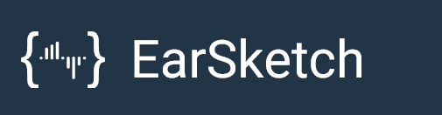


Technology We Will Be Using:
01
02
03
Game-Engine Software
Free educational Coding Environment to create Music
Digital Audio Workstation Software

Slide 6
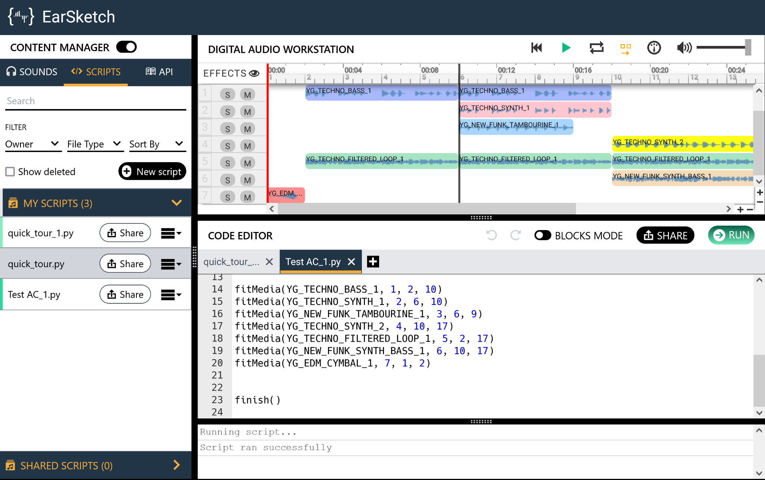
EarSketch
EarSketch is a free web based DAW that allows you to create music tracks through code.
The majority of our workshop will be spent working in this application.
Currently has the option of working in either Python or Javascript.
You can download your track as an .mp3, .wav, text file, and a multi-track file (this option allows you to edit your track in other DAWs such as FL Studio, Garageband, etc).

Slide 7

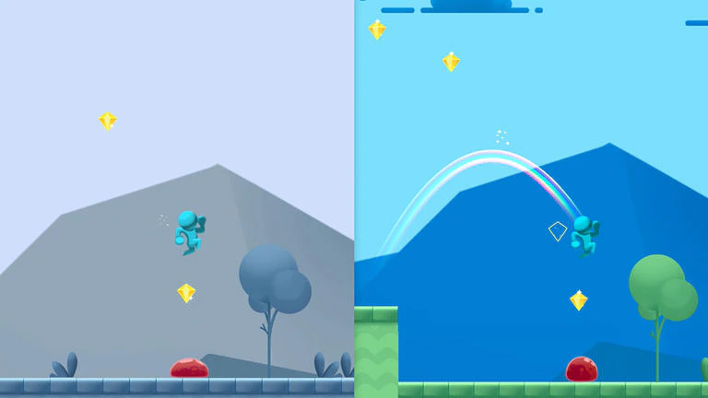
Unity Platform
Unity is a game-engine that supports both 2D and 3D graphics, drag and drop functionality and scripting in C#.
Our project uses the Unity engine to play our rhythm game.

Slide 8
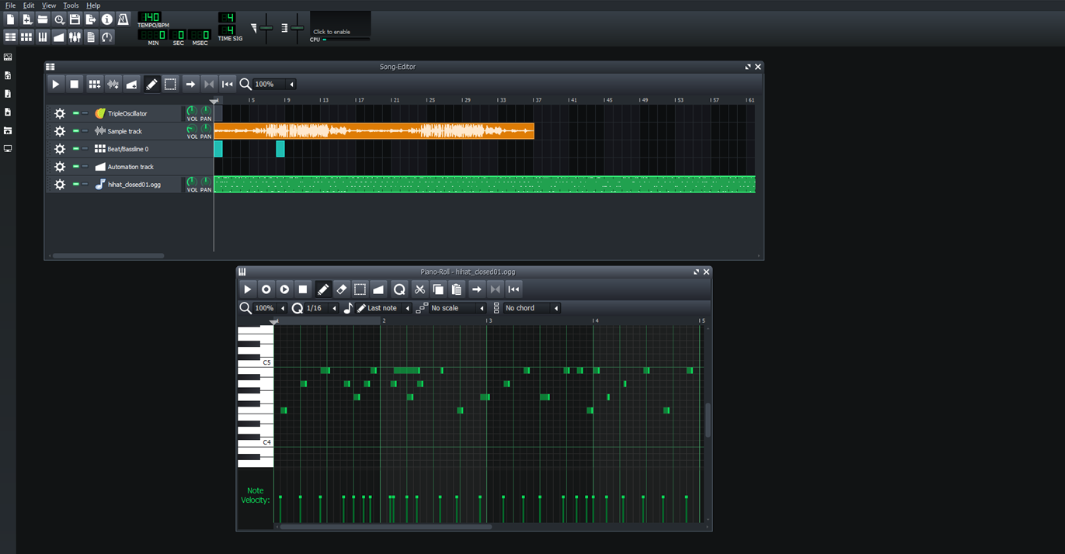

LMMS
LMMS is a free audio workstation that can take in sample tracks and help synthesize sounds.
In our project, we used its editor tool to make notes spawn unto certain spots in a track, that way it can generate it into arrow notes in our rhythm game.

Slide 9
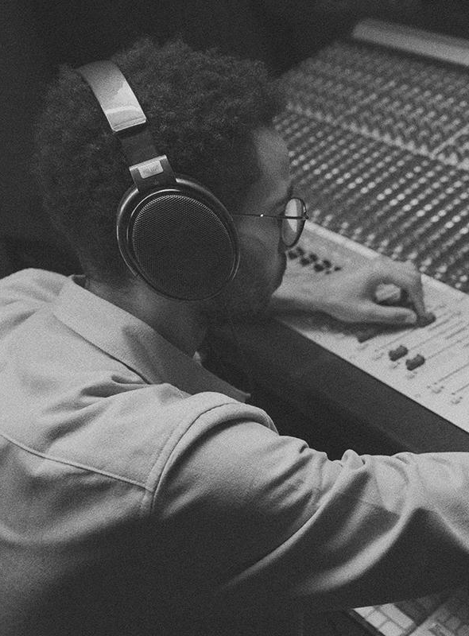
05
WorkShop
Workshop
Workshop
Step-By-Step

Slide 10
Step 1
01
Creating a New Track

Slide 11
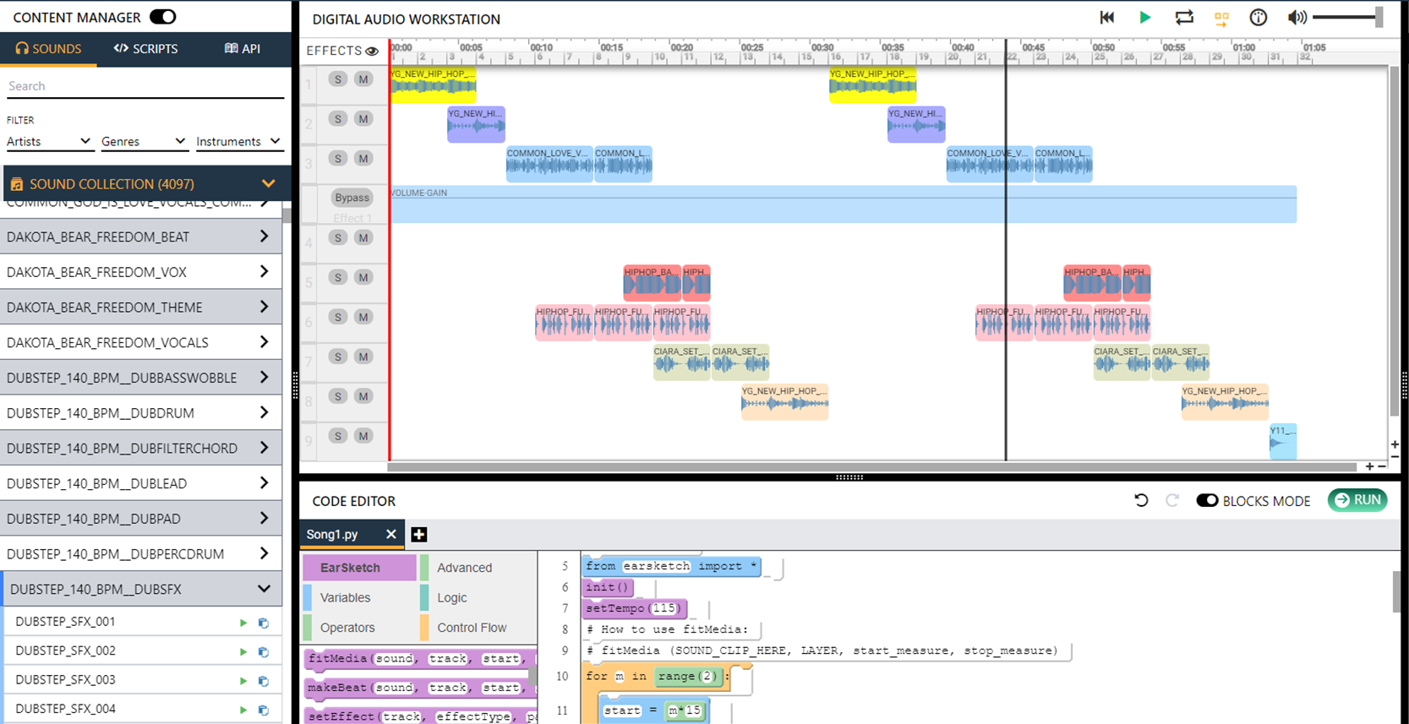
Make a Song on EarSketch
During this workshop, you are going to create a song using a variety of different sound clip from the browser.
We will teach you the basics of EarSketch so you can apply them in your song.
The following slides showcases functions that can be used for your Python music track.
Remember, Python is case sensitive.

Slide 12
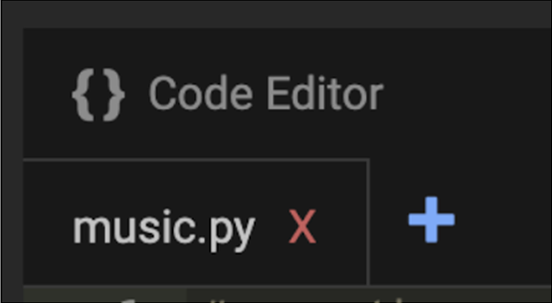
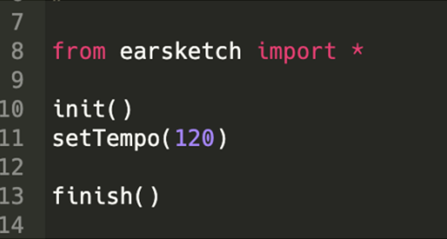
Create Track
Open the EarSketch environment. Before we get started, make sure your file has a .py extension and not a .js one. If not, click the blue + button to create a new file and specify Python as your language from the drop-down option on the right. Feel free to name your file however you see fit; for the purposes of this project, we will be naming it music.py.
When you create a new file, you will automatically have the following lines of code in your project:

Slide 13
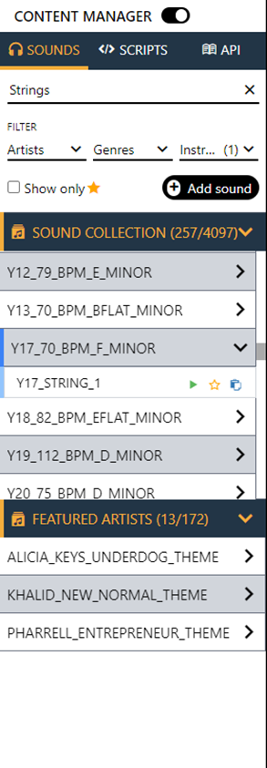
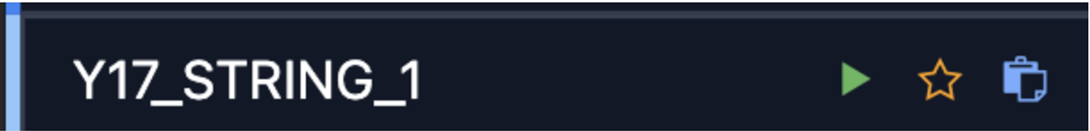
Content Manager
Click on the headphone icon at the top to open up a collection of sound files from Earsketch.
We’ll be starting by adding the sound of string instruments to our file. Click on the dropdown menu Instruments, check Strings, and scroll through the results until you get to a file named “Y17_70_BPM_F_MINOR.”

Slide 14

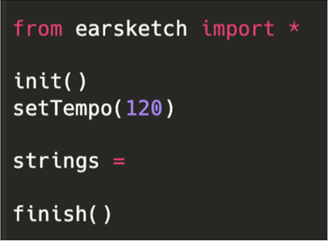
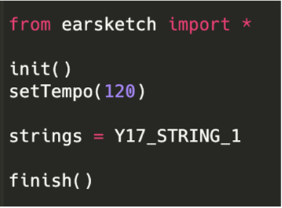
Set Sound
Under setTempo(), create a new variable by typing in “strings =”.
Once we have a variable name set up, now we can go click the blue copy-paste button from before to insert the file into our project.

Slide 15
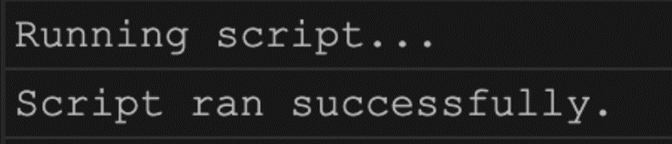

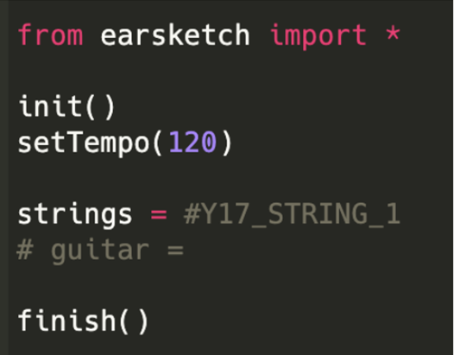
Run Script
You can run your code to make sure it properly works by looking at the right hand side of the screen and pressing .If there no errors, you will receive the following message at the bottom of your screen:
Commenting ensure your program to ignore segments you don’t want to keep in but might want to use later. To comment type # in front of the code.

Slide 16
Step 1
02
fitMedia()

Slide 17
fitMedia()
1.clipName: A string (or constant) specifying the name of the sound clip to add.
2.layer: An int specifying the track to add the clip to.
3.startMeasure: a float specifying the measure location to place the clip on the track.
4. endMeasure: A float specifying the measure location to stop the clip.
# = comment

Slide 18
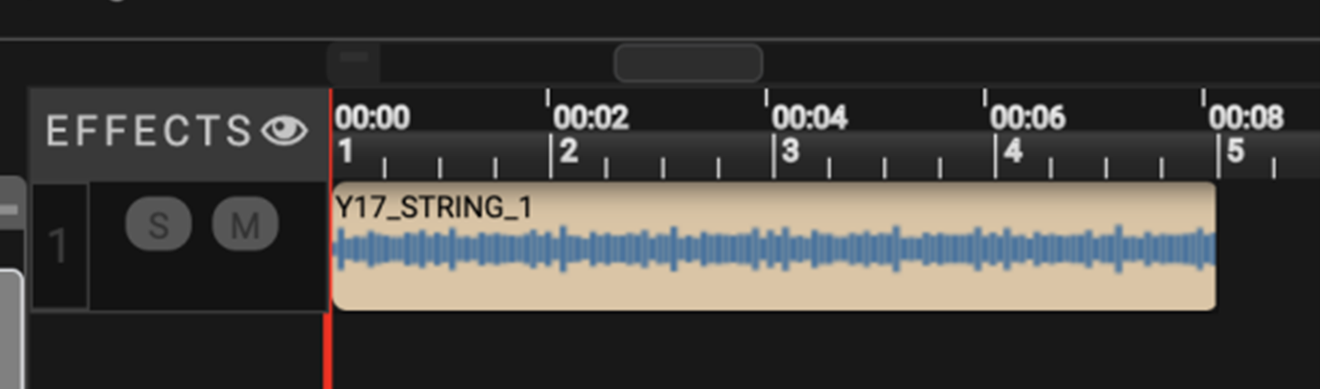
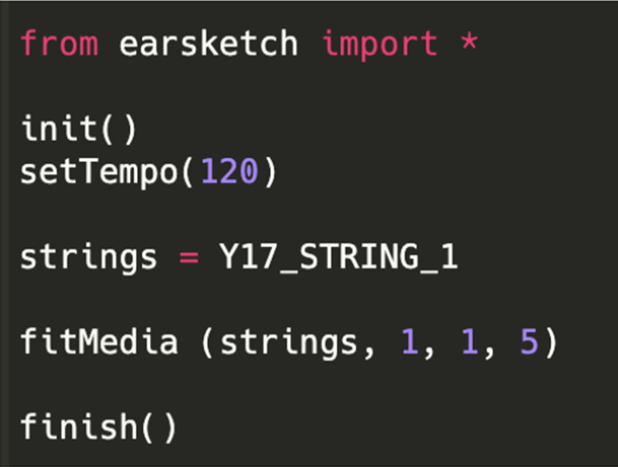
fitMedia()
Now, we add fitMedia to our code. Remember to capitalize the M in media, or else your code will not run properly.
Now when we run the program, you will see your string file appear in your timeline.

Slide 19
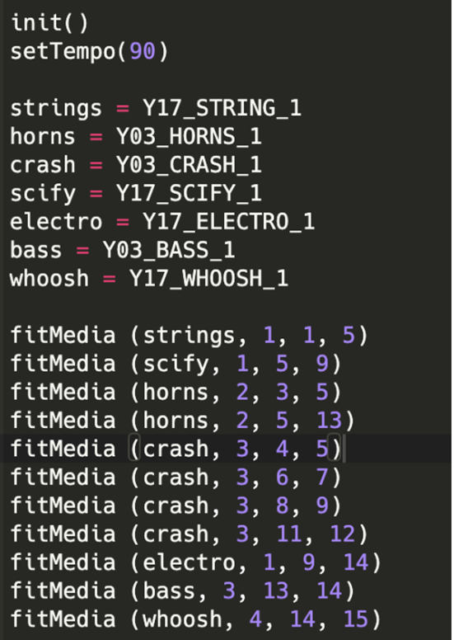
Example

Slide 20
Step 1
03
setEffect()

Slide 21
setEffect()
1.track - the track that you want this effect to be added to.
2. name - the name of the effect you want to add.
3.effect parameter - each effect has its own set of parameters specific to each effect. You cannot mix and match these parameters with other effects.
4. value - like parameters, the values represent different results for each parameter. Each effect has its own range of values that can be used

Slide 22
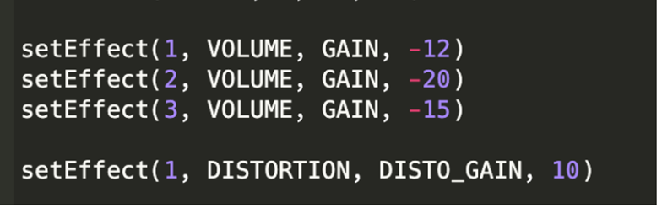
setEffect()
Volume GAIN =Ranges from -60.0 decibels to 12.0. 0.0 is original sound.
Distortion =Ranges from 0.0 (no distortion) to 50.0 (max distortion).

Slide 23
Step 1
04
For Loop

Slide 24
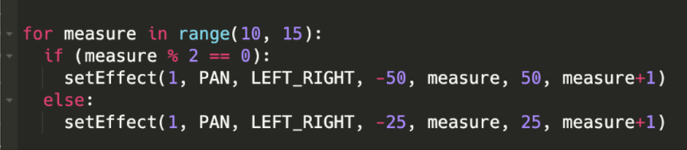
For loop
1.PAN
LEFT_RIGHT = Adjust where the sounds fall between the left and right stereo speakers/headphones. Ranges form -100 (all left) to 100.0 (all right) with 0.0 being center.
Boolean Expression is represented as a double equal (==).
Increment: +=
Decrement : -=

Slide 25
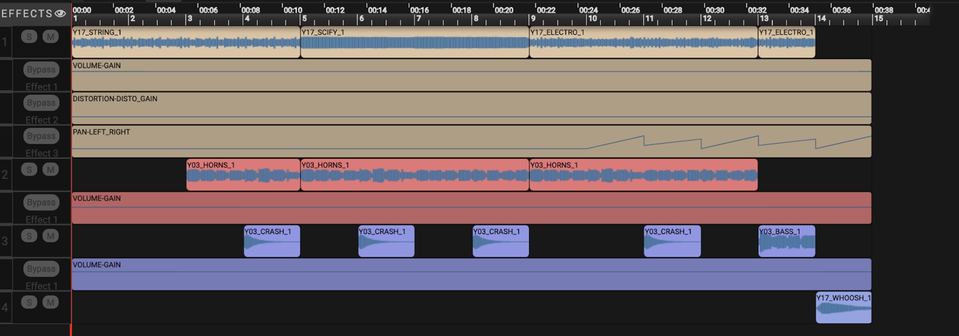
Done!

Slide 26
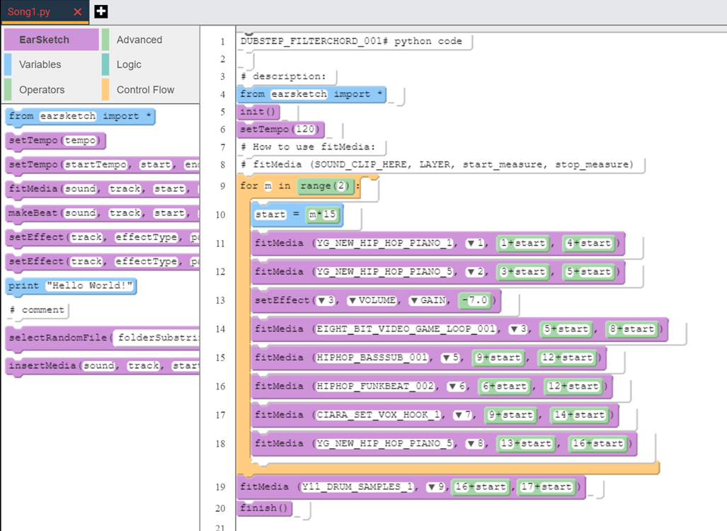
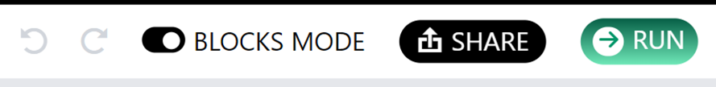
Final Look
After creating a music track that your satisfied with, you can download the track as a WAV file by right-clicking on the name of your Song and clicking download.
You can change your code into block mode by clicking “BLOCKS MODE”.

Slide 27
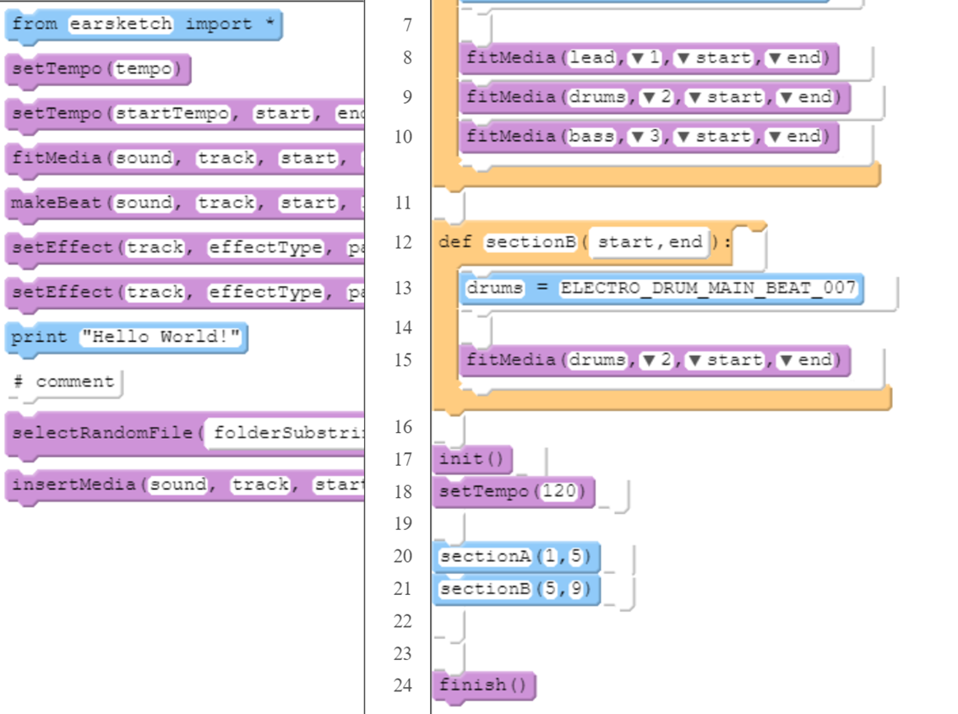
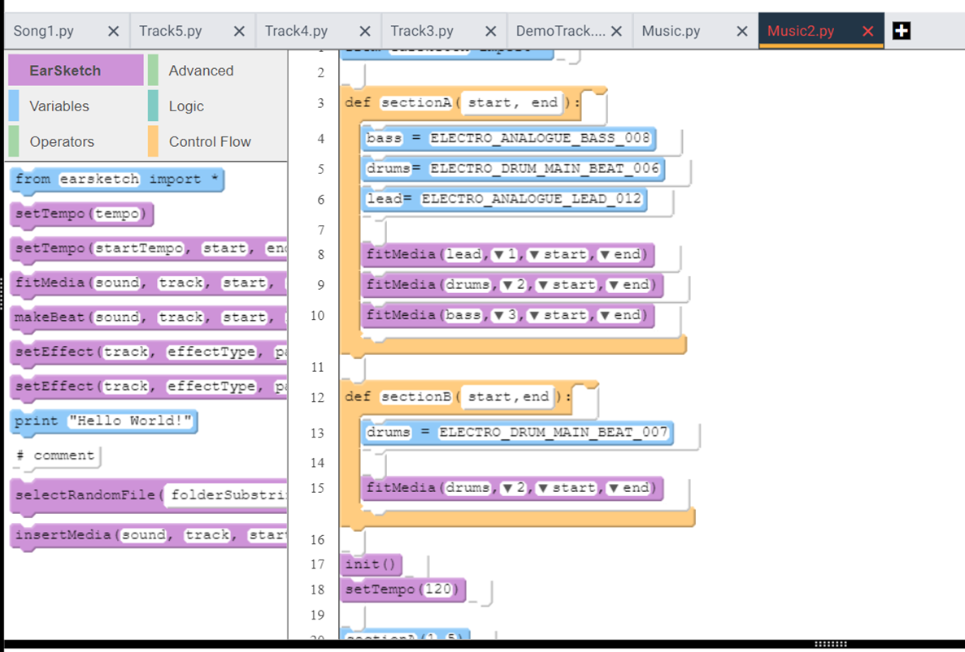
def function
Allow you to DEFine your own function and avoid repeated code

Slide 28

-
SURVEY
Please fill out the survey.
We would love to hear your feedback!
Your answers will be anonymous.

Slide 29
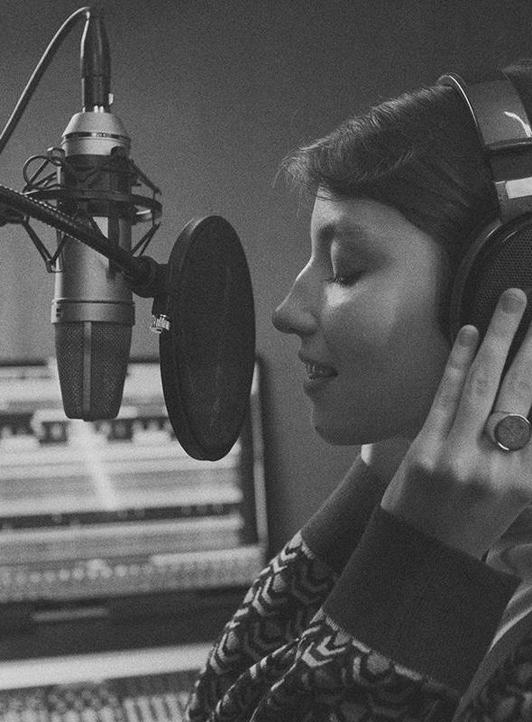
07
QUESTIONS?
QUESTIONS?
QUESTIONS?

Slide 30
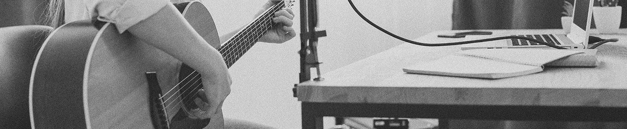
THANK YOU!

Slide 31

FIN

Slide 32
Function Example
setTempo()
setEffect()
def
Sets the temp of the song to a certain beats per minute.
Higher tempo = faster sound
Transform a piece of music by adding effects to smaller portions of a track and define how an effect’s parameter changes over time.
Allow you to DEFine your own function and avoid repeated code

Slide 33
Function Example #2
Variables
makeBeat()
Are virtual boxes that store values for reuse later.
Ex: drum = DRUM_BEAT_1
Create your own rhythmic patterns. Select a media sound and slice them into string.

Slide 34
Function Example #3
While Loops
If Statements
Will execute or skip block of code depending on condition.
Ex:
r= randint(1,3)
If r == 1 : insertMedia(drumA,2,1)
Allows you to execute block of code repeatedly while condition is True.
Ex: x = 1
While x < 9:
insertMedia(clip,1,start)
Start += length
x+=1

